Slide 1
Predictive Modeling and Data Quality Assurance for
EDI Order Processing in Retail Supply Chain
Student Name : Ajitabh Tiwari
Student ID : 2020FC04613
Program / Course : (DSECLZG628T – Dissertation)
Supervisor Name : Raja Sekhar Kandula
Evaluator : Pravin Yashwant Pawar

Slide 2
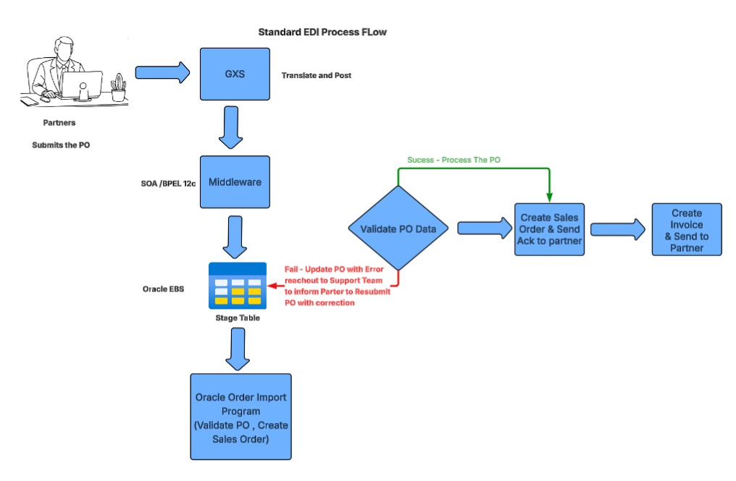
PROBLEM STATEMENT
Retail supply chains rely heavily on EDI for order automation
Oracle EBS processes inbound EDI 850 orders via interface tables
Data quality issues cause frequent order failures
Failures lead to manual rework, delays, and inefficiency
Existing validations are reactive and rule-based
No early risk assessment mechanism

Slide 3
OBJECTIVES & SCOPE
Objectives
Identify data quality issues in inbound EDI orders
Quantify data quality using DQ metrics and DQ score
Assess relationship between data quality and order failure
Scope (Mid-Sem)
Focus on EDI 850 inbound orders
Oracle EBS Order Management
Synthetic dataset due to confidentiality

Slide 4
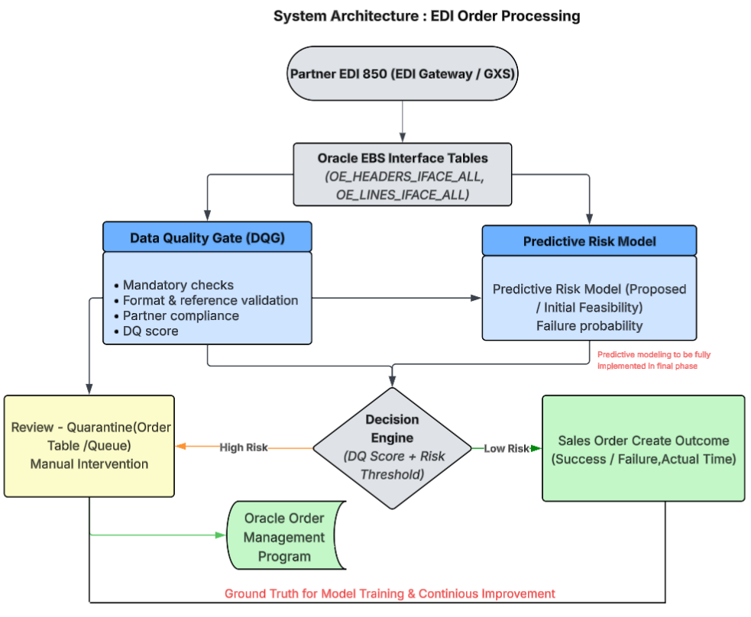
PROPOSED ARCHITECTURE (MID-SEM)
Key Components
EDI Gateway → Oracle Interface Tables
Data Quality Gate (DQG)
DQ Score Computation
Decision Engine
Feedback Loop

Slide 5
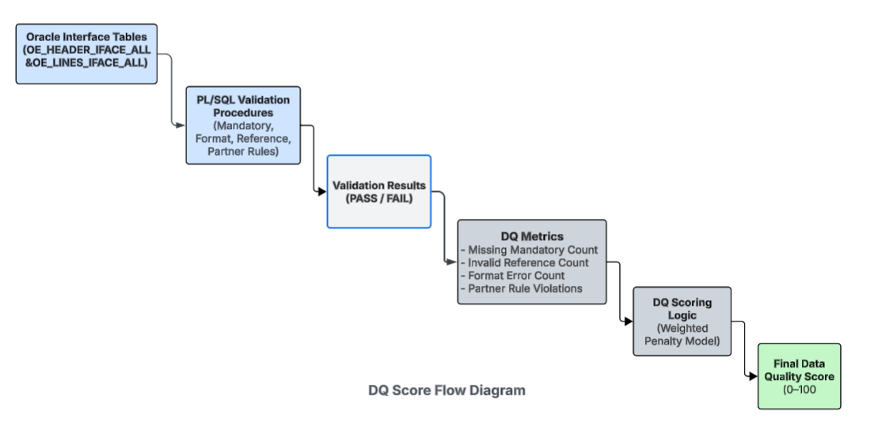
DATA QUALITY FRAMEWORK
DQ Validations
Mandatory field checks
Format validation
Reference data validation
Partner-specific rules
DQ Metrics
Missing mandatory count
Invalid reference count
Partner rule violations
DQ Score
Weighted score (0–100)

Slide 6
INITIAL IMPLEMENTATION & RESULTS
Synthetic EDI dataset created
Oracle-style validations applied
DQ scores computed
Observation:
Low DQ score → High failure probability
High DQ score → Successful processing

Slide 7
Plan for Final Phase – Implementation Roadmap
Step 1: Extend Data Quality Framework
Refine existing DQ rules and metrics
Enhance DQ score calculation using historical patterns
Step 2: Predictive Failure Modeling
    Use DQ metrics as input features
    Train classification models (Random Forest / XGBoost)
    Predict probability of EDI order failure
Step 3: Processing Time Estimation
Derive E2E processing time from key timestamps
Use regression models to estimate processing duration
Analyze impact of data quality on processing time
Step 4: Decision Engine Integration
Combine DQ score and prediction outputs
Route orders based on risk and expected processing time
Step 5: Dashboard & Visualization
Display order success vs failure
Show DQ score bands and risk distribution
Monitor average processing time trends
Step 6: Model Evaluation & Feedback
Evaluate model accuracy and error metrics
Use actual outcomes to retrain and improve models

Slide 8
CONCLUSION
Data quality is critical for EDI success
DQ score provides early reliability assessment
Mid-Sem establishes strong foundation
Final phase will focus on predictive analytics

Slide 9
THANK YOU!

